Slide 1
Prerequisites For 1pm-2pm Session
1. For windows only, download WGet from here, and install it. (Mac OSX already has Wget)
http://downloads.sourceforge.net/gnuwin32
/wget-1.11.4-1-setup.exe
2. Get the latest version of my Gradle example project from the following GitHub repository and unzip it within your Eclipse workspace. For example: C:\Eclipse\workspace
http://djangofan.github.io/selenium-gradle-example

Slide 2
Selenium2 WebDriver
Shortcuts to success in automation using Java, Gradle, Groovy, and Eclipse.
by Jon Austen
Senior SQA Engineer

Slide 3
Where Is The Example Code
Project:
https://github.com/djangofan/selenium-gradle-example
( requires Eclipse Kepler and Gnu Wget )
Test Site:
http://djangofan.github.io/html-test-site/index.html

Slide 4
Optional Configuration Of Eclipse Kepler
1. Define your system JAVA_HOME variable as a JDK. For example: C:\Java\jdk1.7.0_25_x64 . Add its bin directory to the beginning of your system PATH.
2. Unzip Eclipse to C:\Eclipse64 . Optionally, edit the file C:\Eclipse64\eclipse.ini to have the following 2 lines at the top of the file:
-vm
C:/Java/jdk1.7.0_25_x64/bin/javaw.exe
3. Start Eclipse and put the workspace at either: C:\Eclipse64\workspace or at another location like: C:\QaTools\GradleProjects . The default for this location is in your user home directory in a "workspace" subdirectory.
4. Before creating your first project, edit Eclipse preferences and enable preferences such as line numbering and spaces for tabs.

Slide 5
Configure Gradle in Eclipse
Configure "MarketPlace":
1. Skip these steps for Eclipse Kepler.
2. Add the "Eclipse Marketplace" plugin to Eclipse if you have an older version of Eclipse. This would require the following software repository to Eclipse: http://download.eclipse.org/releases/juno/ .
3. Using "All Available Sites", and using "market" as a search filter, install the Eclipse Marketplace plugin.
4. Restart Eclipse.
Install Gradle :
1. Just pull down the Help menu in Eclipse and open the "Eclipse Marketplace" panel and search for Gradle and install it.
2. Optionally, from the marketplace, you can also install the M2E Maven plugin, PyDev plugin for Python, and/or the Groovy plugin.

Slide 6
What is in this talk?
1. Using Gradle to execute Selenium tests.
2. An example of running parallel WebDriver instances with Gradle.
3. An example of running with multiple windows per driver instance with Gradle.
4. Page objects with a Fluent API.
5. A sample configuration for running Grid Hub and Nodes.
6. Ideas for handling StaleElementReference and other exceptions.

Slide 7
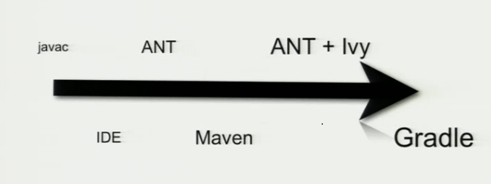
History of Gradle
A timeline:

Slide 8
Install Standalone Gradle
Install Gradle on your system.
1. Download the latest version of Gradle from the http://www.gradle.org/ site.
2. Unzip it to a location such as C:\Java\Gradle1.7 and that will be your GRADLE_HOME location. Create a GRADLE_HOME system environment variable with the above location value.
3. I suggest adding Gradle to your system path by adding the following to the end of the PATH variable: %GRADLE_HOME%\bin
4. Optionally, you can download and install Groovy with similar steps as the above. Gradle does have the ability to use Groovy script without downloading Groovy separately.
5. In Eclipse, I suggest that you configure the Gradle plugin to use this Gradle distribution that you just downloaded. There is a Gradle configuration panel in the Eclipse global 'Preferences', from the 'Window' drop-down menu.

Slide 9
Create a project from command line
When you configure a basic Gradle project, people usually define the Gradle plugins that they want to use in the first few lines of the build.gradle script. For example:
apply plugin: 'java'
apply plugin: 'eclipse'
Gradle uses the SML (standard maven layout) for describing the location of source files. Some examples:
src\main\java
src\main\resources
src\main\groovy
src\test\java
src\test\resources
Shortcut: When creating a brand new project, Gradle also has the ability to generate this structure for you with the following command:
PS C:\CTemp\MyProject> gradle setupBuild --type java-library

Slide 10
Importing Gradle projects in Eclipse
1. The Spring Source site has instructions on how to import projects here: http://static.springsource.org/sts/docs/latest/reference/html/gradle/gradle-sts-tutorial.html .
I will demonstrate this later in this talk and in the next few slides.
2. For most projects, when importing, the root project is the folder where the settings.gradle exists and that file contains the 'include' DSL keyword that specifies the subdirectories for your multi-project build.

Slide 11
settings.gradle
include "commonlib", “etsy", "parallelwindows"

Slide 12
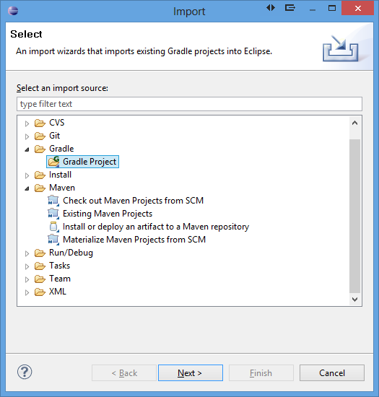
Importing Gradle project in Eclipse

Slide 13
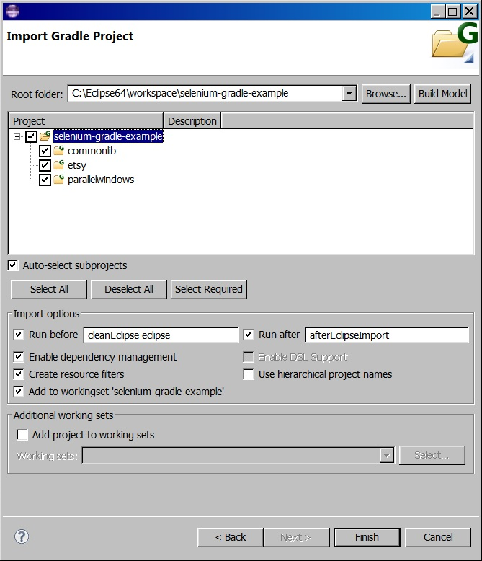
The build layout can be thought of like this:
selenium-gradle-example
--> commonlib
--> etsy
--> parallelwindows

Slide 14
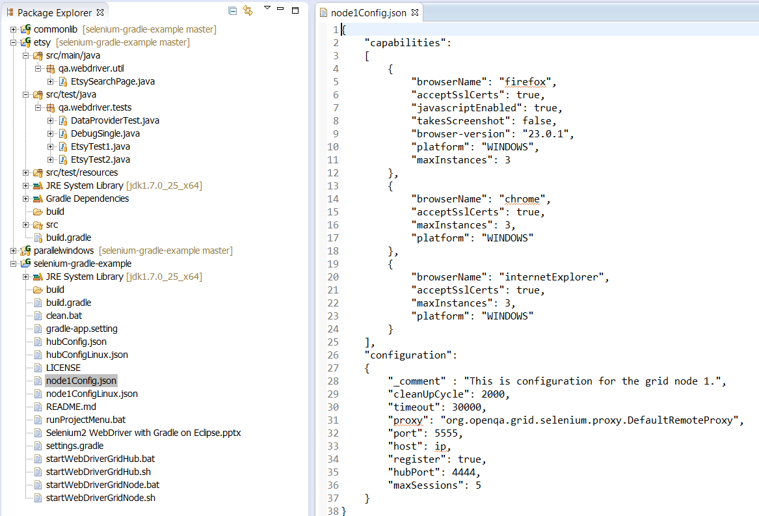

Slide 15
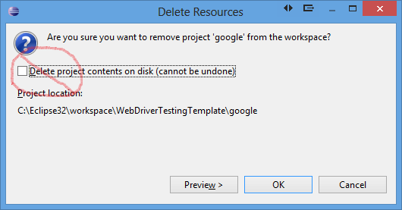
Tip: Delete a Gradle project
1. When deleting a Gradle project from Eclipse, do not choose to delete the project on disk. If your code is in source control, its safe, but I still don't recommend checking the 'delete' box :

Slide 16
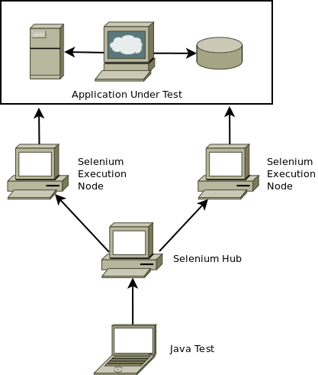
Selenium Grid
First, start the Grid hub:
java -jar selenium-server-standalone-2.14.0.jar -role hub
Then, start at least one node:
java -jar selenium-server-standalone-2.14.0.jar -role node -hub http://localhost:4444/grid/register
127.1:5555
127.1:5556
127.1:4444

Slide 17
Run your Grid Hub and Node
I prepared scripts to start your Grid Hub and Nodes for you. At the root of the selenium-gradle-example project, there are .bat, .sh, and .json files for starting these.
For Windows:
startWebDriverGridHub.bat
startWebDriverGridNode.bat
hubConfig.json
node1Config.json
(Screenshot on next slide.)

Slide 18
Gradle Scripts Are Groovy Scripts
task hello << {
println 'Hello world!'
}
task intro(dependsOn: hello) << {
println "I'm Gradle"
}
> gradle -q intro
Hello world!
I'm Gradle
classesDir = new File('build/classes')
task resources << {
classesDir.mkdirs()
// do something
}
task compile(dependsOn: 'resources') << {
if (classesDir.isDirectory()) {
println 'The class directory exists. I can operate'
}
// do something
}

Slide 19
Gradle parallel workers
Gradle can process a test task in parallel multi-threaded mode. You just define your tasks in your build.gradle like so:
tasks.withType( Test ) {
jvmArgs '-Xms128m', '-Xmx1024m', '-XX:MaxPermSize=128m'
maxParallelForks = 4 // this is default if task doesn't override
}
task runParallelTestsWithFirefox( Type: Test ) {
maxParallelForks = 2
description = 'Runs all JUnit test classes in 2 parallel threads.'
include '**/Test*.class'
reports.junitXml.destination = "$buildDir/test-results/GoogleTestIE"
reports.html.destination = "$buildDir/test-results/GoogleTestIE"
systemProperties['hubUrl'] = 'localhost:4444'
systemProperties['browser'] = 'firefox'
}

Slide 20
Parameterizing a JUnit test
Just like TestNG, Junit now has parameterized capability in Junit 4.11 (since late 2012). This is an example of how I read a .csv file for my unit tests.
@RunWith( Parameterized.class )
public class GoogleTest extends StaticUtilityClass {
private String testName = "JUnit test";
@Parameters(name = "{0}: {1}: {2}")
public static Iterable<String[]> loadTestsFromFile1() {
File tstFile = new File( System.getProperty("user.dir") + "testdata.csv" );
List<String[]> rows = null;
if ( tstFile.exists() ) {
CSVReader reader = null;
try {
reader = new CSVReader( new FileReader( tstFile ), ',' );
rows = reader.readAll();
} catch (FileNotFoundException e) { e.printStackTrace(); }
}
return rows;
}
....
}

Slide 21
Logging tests with SLF4j + Logback
I use simple logging using the Logback method, which is related to the SLF4j Java project. This method will log to console and to file if you pass "-info" or "-debug" as an argument to the tests.
---------------------------------------
import org.slf4j.Logger;
import org.slf4j.LoggerFactory;
public abstract class StaticUtilityClass { // this class gets extended by tests
static Logger staticlogger = LoggerFactory.getLogger( StaticUtilityClass.class );
Logger classlogger = LoggerFactory.getLogger( getClass() ); //instance logger
.....
---------------------------------------
<appender name="STDOUT" class="ch.qos.logback.core.ConsoleAppender">
<encoder><pattern>%-4r [%thread] %-5level %logger{35} - %msg %n</pattern></encoder>
</appender>
<appender name="FILE" class="ch.qos.logback.core.FileAppender">
<file>build/junit.log</file>
<append>false</append>
<encoder><pattern>%-4r %-5level %logger{35}: %msg%n</pattern></encoder>
</appender>
<root level="DEBUG">
<appender-ref ref="FILE" />
<appender-ref ref="STDOUT" />
</root>

Slide 22
WebDriver wait for WebElement
WebDriver has built in 22 methods for waiting for web page elements in the ExpectedConditions.class . Here are 2 examples:
Wait<WebDriver> wait = new WebDriverWait( driver, 30 );
wait.until( ExpectedConditions.titleContains( "Application Title" ) );
wait.until( ExpectedConditions.invisibilityOfElementLocated( By.name( “backtomain” ) );
You can also make your own expected conditions:
Wait<WebDriver> wait = new WebDriverWait( driver, 30 );
WebElement we = wait.until( new ExpectedCondition<Boolean>() {
public WebElement apply( WebDriver webDriver ) {
System.out.println( "Searching..." );
return webDriver.findElement( By.id( "pb4_status" ) ) != null;
}
} );
assertEquals( "Progress bar not completed!", "Completed!", progressBar.getText() );
All of these wait methods are problematic if you do not handle their special case exceptions like StaleElementReferenceException and NoSuchElementException.

Slide 23
WebDriver wait for WebElement
In order to enable your test to retry when there is an exception, here is a manual method to understanding handling error conditions on findElement() :
public static WebElement getElementByLocator( By locator ) {
driver.manage().timeouts().implicitlyWait( 15, TimeUnit.SECONDS );
WebElement we = null; boolean unfound = true; int tries = 0;
while ( tries < 4 ) { // try for 1 minute
tries +=1;
try {
we = driver.findElement( locator );
break; //found it
} catch ( StaleElementReferenceException e ) {
logger.DEBUG("Element not found after try #" + tries); // will try again
}
}
driver.manage().timeouts().implicitlyWait( DEFAULT_IMPLICIT_WAIT, TimeUnit.SECONDS );
return we;
}

Slide 24
Ignore exceptions with FluentWait
You can ignore exceptions with FluentWait instead of handling them explicitly. This example waits for 30 seconds, polling every 5 seconds, and ignoring exceptions on every poll until the 30 seconds is finally reached:
Wait<WebDriver> wait = new FluentWait<WebDriver>( driver ) .withTimeout(30, SECONDS) .pollingEvery(5, SECONDS) .ignoring( NoSuchElementException.class ); WebElement foo = wait.until( new ExpectedCondition<Boolean>() { public WebElement apply( WebDriver webDriver ) { return webDriver.findElement( By.id("foo") ); } } );
Using JDK 1.8 , using a Lambda expression :
wait.until( webDriver -> webDriver.findElement( By.id("foo") ) )

Slide 25
Handling popup windows
This is an example of how I switch from one window to the next:
public Boolean switchToWindowByHandle( String handleName ) {
boolean found = false;
Set<String> allHandles = driver.getWindowHandles();
for ( String handle : allHandles ) {
System.out.println( "Open window handle id: " + handle );
if ( handleName.equalsIgnoreCase( handle ) ) {
driver.switchTo().window( handle );
found = true;
}
}
if ( found ) {
System.out.println( "Found window and switched to it." );
} else {
System.out.println( "Failed to switch to window handle. Not found." );
}
return found;
}

Slide 26
Handling iFrames
Using WebDriver, a frameless page is referenced by TargetLocator.defaultContent() . In other words, after switching into an iFrame, to get back to the main window you should use driver.switchTo().defaultContent() . On a page with a single iframe, you can just reference it using TargetLocator.frame(0) .
Now, suppose there are multiple frames. You can loop them like this:
public boolean switchToFrame( String id ) { boolean switched = false; List<WebElement> elements = new ArrayList<WebElement>(); elements = driver.findElements( By.tagName("iframe") ); for ( WebElement el : elements ) { if ( el.getAttribute("id").equals( id ) { driver.switchTo().frame( elements.get(i) ); switched = true; } } if ( switched == false ) log("Failed to switch windows."); return switched; }
public exitIFrame() {
driver.switchTo().defaultContent();
Thread.sleep(1000); // optionally give slow DOM some time to be ready
}

Slide 27
Using a Fluent API
Martin Fowler coined the term “Fluent API”. It involves an inner class like the builder pattern.
Builder Design Pattern: fluent methods operate/build on a new object before returning it from the inner class.
Fluent API Pattern: the inner class returns the fluent object first and then the fluent methods operate upon it afterwards.
Some open source projects that use the Fluent API pattern are: Commons CSV, RestAssured, XMLSlurper, JOOQ, and jRTF.

Slide 28
The end. Any questions?
Some questions I could answer:
1. Demonstrate running in IntelliJ-IDEA?
2. How to keep track of window handles?
3. Show the Grid Hub console?
4. Explain use of Seleniums “LoadableComponent” class to load a page object?
5. Difference between forking test processes from Gradle or Maven verses forking from TestNG, Junit, or Scala SBT?
6. Show “Gradle GUI” to run tests?
7. Show the logging output from tests and/or the reports?

